Slide 1
Classes
Lecture # 16
Operator Overloading

Slide 2
Operator Overloading
Operator overloading is a type of polymorphism in which a single operator is overloaded to give user defined meaning to it.
Operator overloading provides a flexibile option for creating new definitions of C++ operators.
Type of polymorphism
Enable C++ operators to work with classes.
Built-in operator overloading.
The compiler generates the appropriate code depending upon the type of the operands.
Notes:
Built-in operator overloading like operators work differently for float, int, double etc. so operators can be overloaded for
classes.

Slide 3
Operator Overloading
Operators are overloaded using functions
Functions are defined to specify operands and functionality.
Operator overloading can be done using members or non- member functions.

Slide 4
Syntax
return-type operator op (arg_list)
{
//Function body;
}
return-type className :: operator op (arg_list)
{
//Function body;
}

Slide 5
Excluded Operators
There are certain operators that can’t be overloaded:
Class member access operator (. (dot))
Pointer to members ( .* (dot-asterisk))
Scope resolution operator (::)
Conditional Operator (?:)
Size Operator (sizeof)

Slide 6
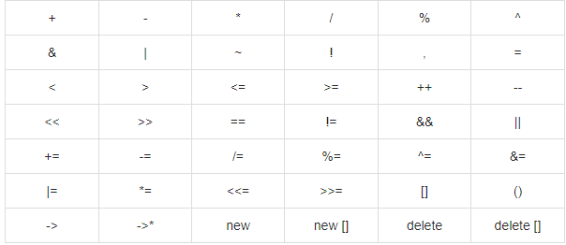
Overloadable Operators

Slide 7
Rules & Restrictions
Precedence of operators cant be changed.
Associativity and arity of operators cant be changed.
New operators cant be created.
The fundamental functionality of operators don’t change. (+ cant subtract)
Related operators like + and += must be overloaded separately.
Notes:
Associativity= if operators normally associates from left to right then after overloading this stays the same.
Arity= The number of operands an operator takes.

Slide 8
Overloading Binary Operator
A Binary operator can be overloaded as a non static member function (one parameter) or non member function( two parameters ).
Non member function is declared a friend of a class.

Slide 9
Example
Box operator+(const Box&);
Box operator+(const Box&, const Box&);

Slide 10
References
https://www.w3schools.in/cplusplus-tutorial/overloading/operator-overloading/
https://www.tutorialspoint.com/cplusplus/cpp_overloading.htm

